Slide 1



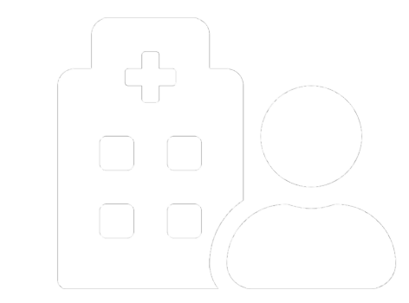
YHWH
Title
You Heal We Help
Mentored By Mr. Jeetesh Srivastava
Final Year Project

Slide 2



Group Members
Piyush Mehrotra
Shivam Singh (84)
Shreya
Shubhangi Soni
Vivek Tripathi

Slide 3

Index
Introduction
Project Objective
Need of Project
Features of Project
Data Flow Diagram
Project Application in Real Life
Future Enhancements
Conclusion
Reference

Slide 4
Introduction
Are you searching for a help, for you or your relative’s faster recovery or for performing rituals if someone died? Do you know which hospitals are having poison cell? Do you want to know more about some bigger diseases from well-known doctors? Don’t have money, for the treatment of your loved one and need help? Don’t worry, this is the reason why we are here:
You Heal We Help
Our project’s main aim is to analyze data and help the needy by recommending the best facilities of hospitals, doctors, specialist near you.
We also help fresher/junior doctors to learn more from experienced doctors and users to get health awareness from them by organizing seminars. We bridge a gap between the poor patients by connecting them directly to the NGOs for instant fund raising.
When anyone is died, and you need help for doing all the rituals regarding him and no one is there to help, don’t worry, we provide all sorts of ritual practices as taking death body from your home to ghat as well as providing the death certificate too.
YHWH

Slide 5
Project Objective
You Heal We Help provides you best quick healing options near you We are helping hands for our users for their quick recovery. Some solutions we provide are:
The main aim of this site is to reduce death rates, by providing faster search results of best rated doctors, facilities and hospitals regarding specific problem and its solution available near them.
It will also organize different seminars for fresher/junior doctors to interact with experienced doctors. A health awareness program for public user about new diseases, its causes and solutions.
As the services and interactions are improved in all possible ways, everything is being planned with greater precision.
It also helps to connect with NGOs for instant fund raising for the needy.
In pandemic situations or disasters or for upcoming generations, people need help for the cremation of their loved ones because of not known about rituals or pandemic doesn’t allow people to help, so in these situations we provide a helping hand for such people.

Slide 6
Why Need this ?
Hospital management system is being used everywhere but most of them deals with the doctor’s availability and their appointments, medicine available or not. Some more problems are:
People facing difficulties in finding poison cell, beds, oxygen, ventilators, blood and plasma for their near and dear ones.
Lack of awareness of diseases and symptoms is essential for screening and early detection.
Specially the problems are faced in times of pandemic or any natural disasters it becomes onerous to cremate the body of so many people.
Need for instant money or funding for treatment is also a challenge for the poor ones or middle class people.

Slide 7
Existing Scenario
The existing systems are highly manual and all work is done traditionally or if they are online then they either provide information regarding doctor’s availability or names of hospitals, or medicine delivery.
One has to go to different hospitals to find whether it has poison cell or not.
One has to find out whether the treatment for the disease for which they are looking is available in that hospital or not.
After that, one has to collect information about charges and everything else there.
People in need for money go to social media and post for fund raising which takes a lot of time.
Some new diseases are still unknow for small area or small doctors, because of which it takes much time for them to diagnose.

Slide 8
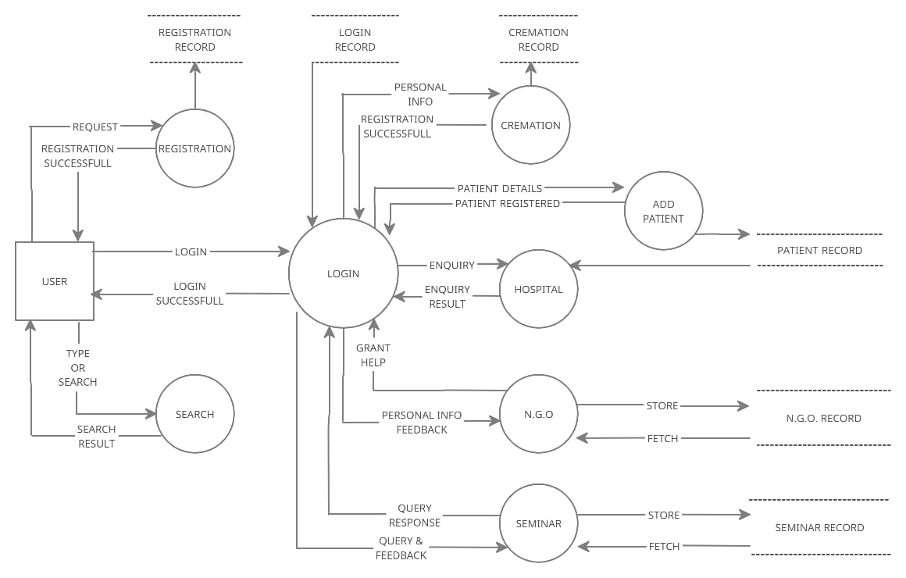
DFD of User

Slide 9
Technology Used
Requirement analysis:
Ideas and analysis of market and need for a common person in medical and support
Design
Creately App
Adobe XD
Web Development:
Frontend:
HTML, CSS
Bootstrap framework
Js
Backend:
Php
Database:
Xampp Server

Slide 10
Future Enhancements
Live tracking way to nearest best hospital: We will add maps to find a route to your selected nearest hospital.
Video/Tele consultation with doctors: You can book an online video/tele consultations appointments with doctors for there advise or regular checkup. This will often more helpful and convenient for patients, saving them time and money and reducing the stress of travelling to their appointments and specially in pandemic times.
Special Module for women health and mental health issues: Time to time, automatic appointment generation of registered women with doctors related to the woman’s disease or with psychologist.
Health tracker (IOT device or a mobile app): This will help for user to keep track of their health, if needed can be shared with doctors regarding any issues or queries for maintain their health.

Slide 11
Conclusion
Taking into account all the mentioned details, we can make the conclusion that the hospital management and cremation is the inevitable part of the lifecycle of Today’s world.
We would be working on it continuously for more enhancements. At every stage while studying we were cardinally supported by our mentors and department.
Thankyou….

